Slide 1
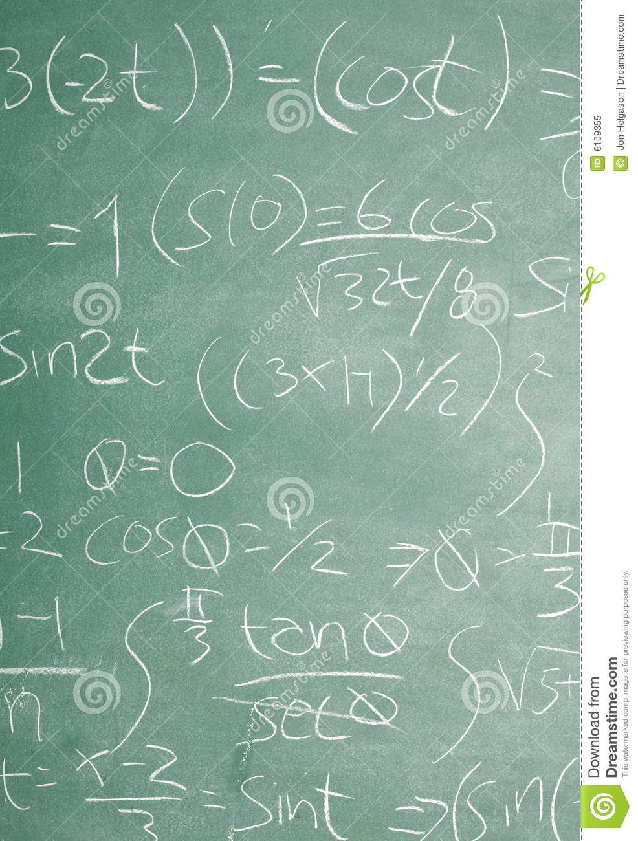
thanksgiving
an equation

