Slide 1
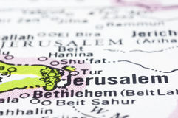
Pray for the peace
of Jerusalem…

